Slide 1
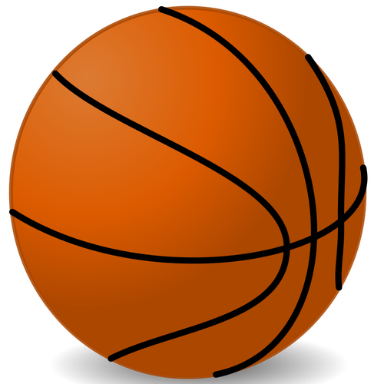
Hobbies
Bakchina Victoria, Pchelnickova Darya,
Mustafina Adelina 8Б,Pudyaneva Marya 8А

Slide 2
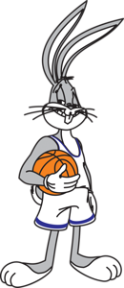
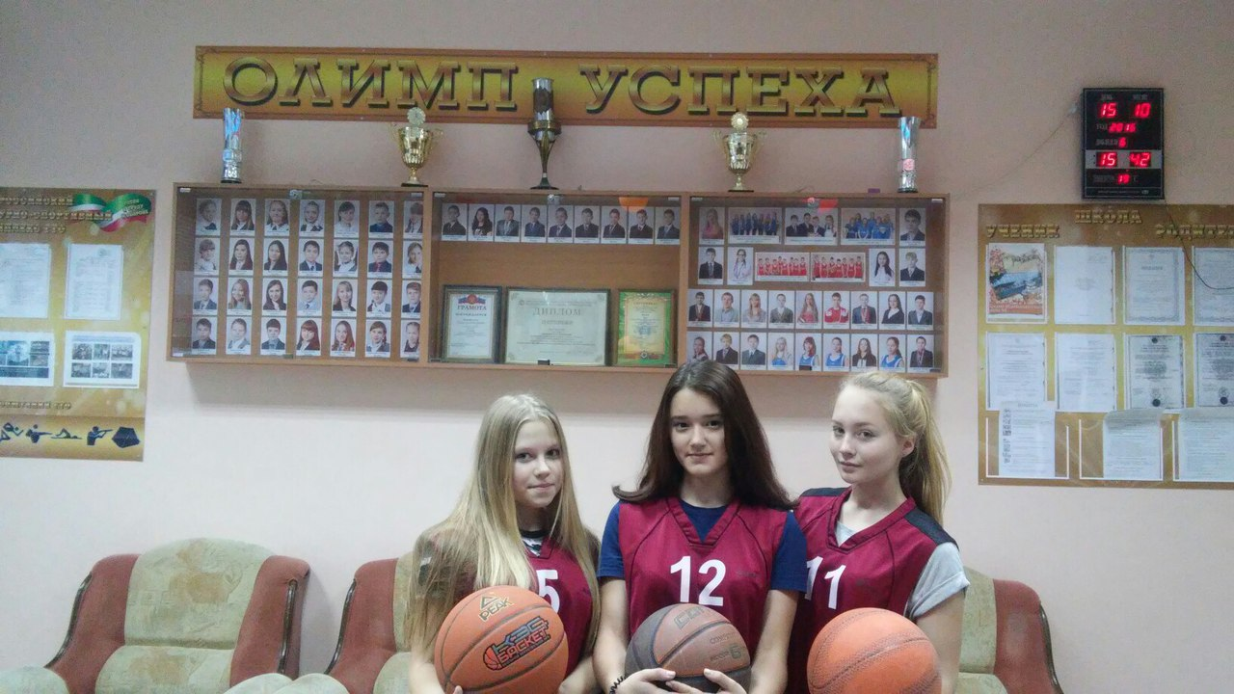
Basketball

Slide 3
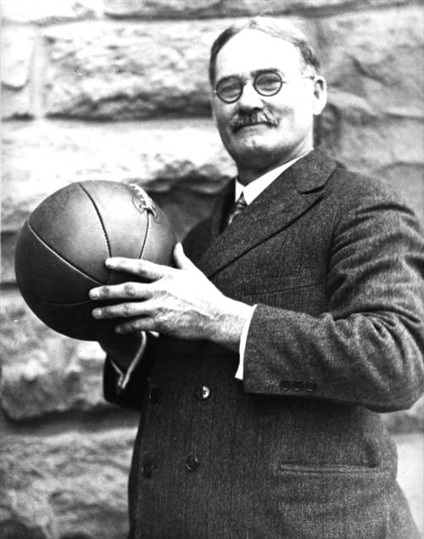
21 December 1891 James Naismith
tied two baskets of peaches under the railing of the balcony of the sports hall and eighteen students were divided into two teams, invited them to a game, the main idea of which was to score more goals into the
opponents ' basket.

Slide 4
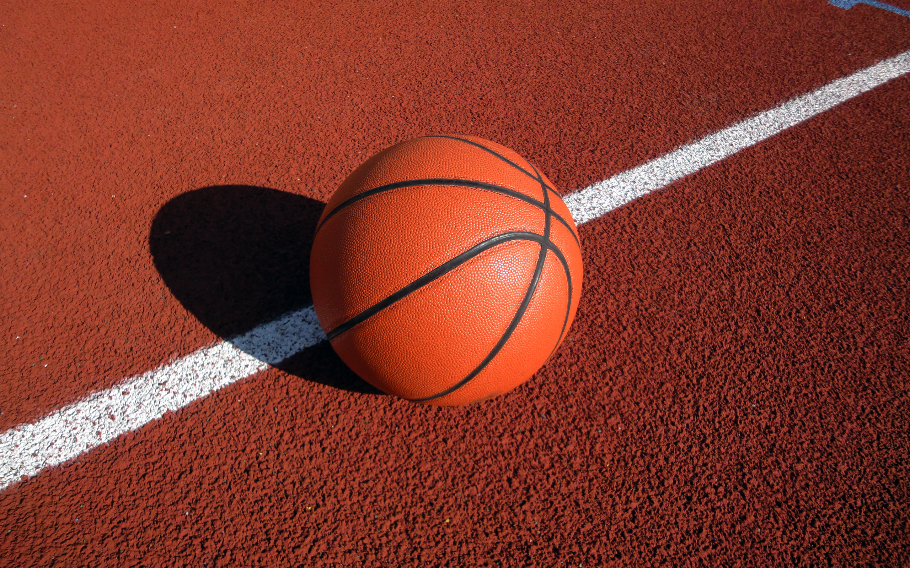
Basketball - a game that perfectly trains the body and relieves stress and accumulated negative emotions.
Basketball develops endurance, coordination, positive effects on the nervous, cardiovascular and respiratory system. Some exercises of modern basketball so useful that were included in many courses of therapeutic physical training.
Also in the basketball section you can find a lot of new friends.

Slide 5
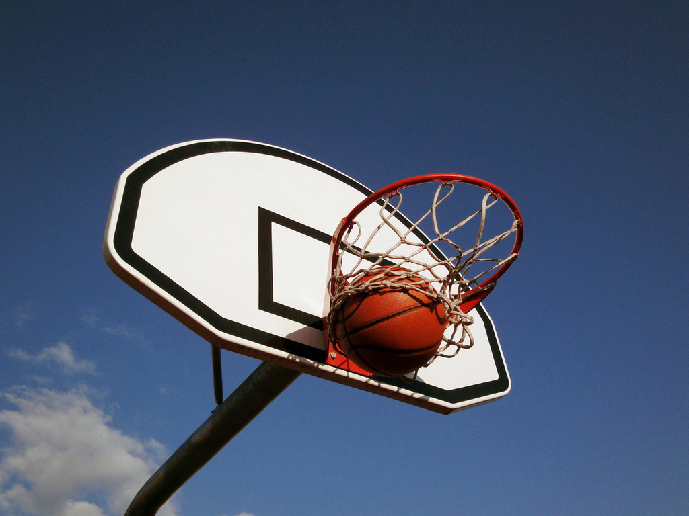
Basketball develops
respiratory system
Endurance
coordination
Cardiovascular system

Slide 6
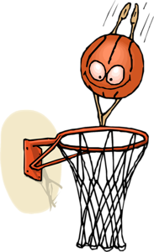
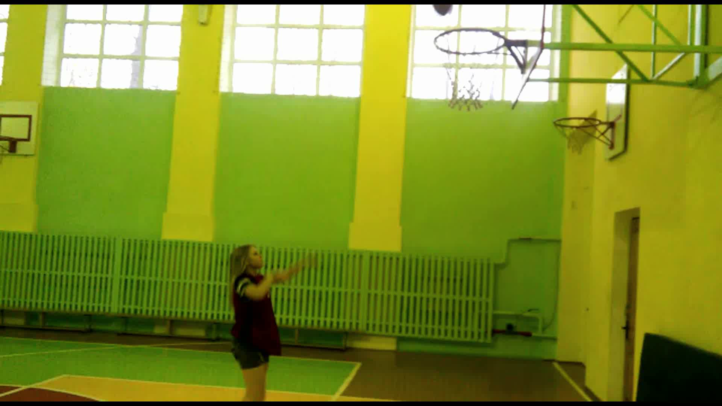
At the beginning of trainings we do a lot of variety exercises to warm up

Slide 7
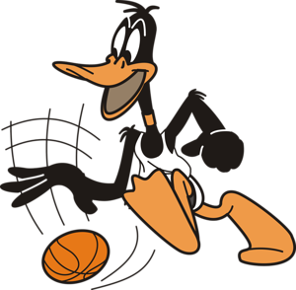
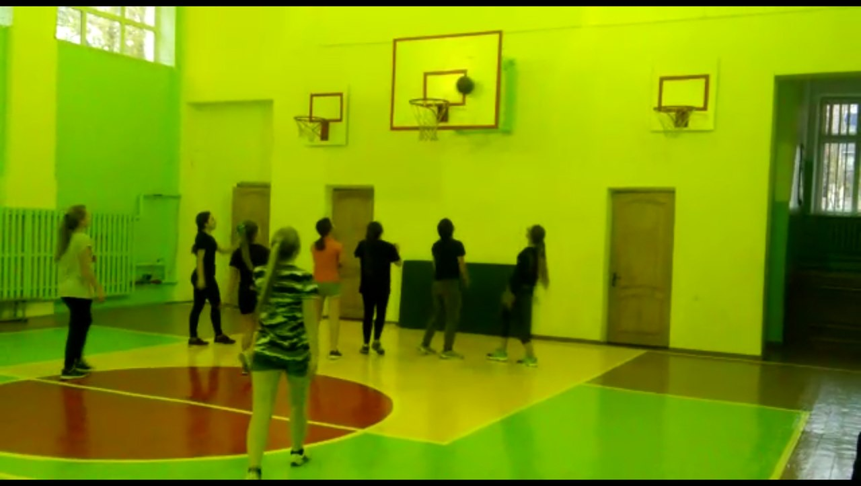
Then we are divided into two teams and compete with each other

Slide 8
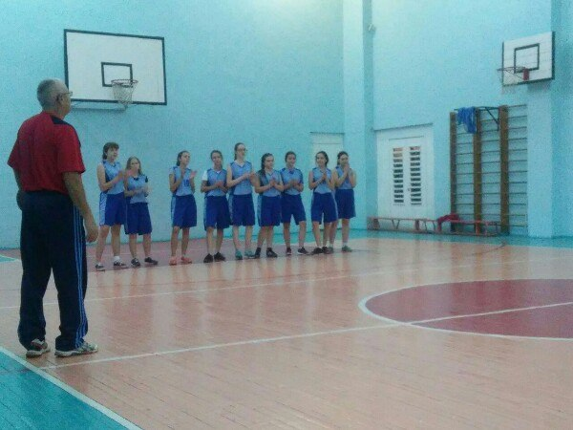
In our school there is a section of basketball for boys and girls. Training for girls are held on Tuesdays and Saturdays.
They are fantastic! Welcome to our section. You’ll get positive emotions, make new friends, be healthy!

Slide 9
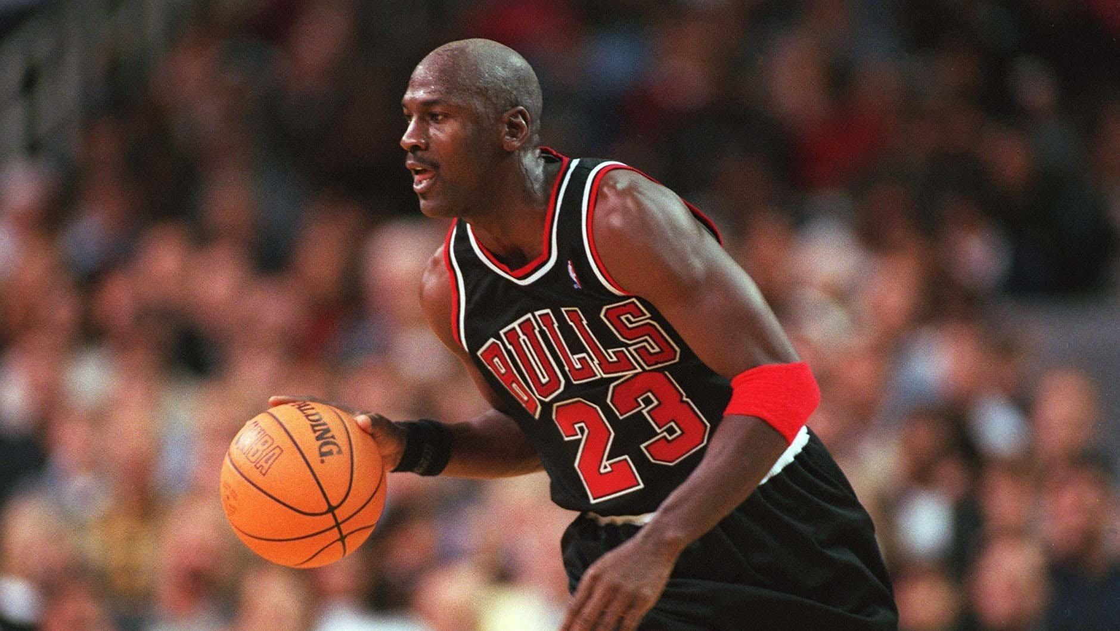
Thank you for attention!
— Michael Jordan

